Slide 1


Time
Series Forecasting
Different Forecasting Model

Slide 2
Content
Time series forecasting
Different Components of Time Series
Decomposition and Stationarity Test
Data Transformation to Achieve Stationarity
Plotting ACF and PACF
Statistical Models of time series forecasting AR MA ARMA ARIMA
Time Series Forecasting using Statsmodel library

Slide 3

Problem & Solution
Forecast the sales , weather and so on.
Economic Forecasting and census analysis
Time Series Forecasting
Optimal business decision

Slide 4
What is Time Series Forecasting ?
Time series forecasting is the process of analyzing time series data using statistics and modeling to make predictions and inform strategic decision-making.
While forecasting and “prediction” generally mean the same thing, there is a notable distinction. In some industries, forecasting might refer to data at a specific future point in time, while prediction refers to future data in general.
Series forecasting is often used in conjunction with time series analysis. Time series analysis involves developing models to gain an understanding of the data to understand the underlying causes. Analysis can provide the “why” behind the outcomes you are seeing. Forecasting then takes the next step of what to do with that knowledge and the predictable extrapolations of what might happen in the future.

Slide 5
When we use Time series over Regression?
The main difference between them is the order in which data is worked with.
In time series analysis data is a sequence within an event taken at successive equally spaced points in time. Some examples could include index values at the close of market, daily temperatures at 5pm and total accumulated rainfall at midnight.
Regression analysis is the utilization of current input values to one or more independent time series and testing the effect on another time series.
The difference between the two is time series is used to predict a value at a particular point of time during the day using previous values from that same point in time on previous days, where regression analysis is used to test theories about current values.

Slide 6
Applications
Forecasting power demand to decide whether to build another power generation plant in the next five years
Forecasting call volumes to schedule staff in a call center next week
Forecasting inventory requirements to stock inventory to meet demand
Forecasting supply and demand to optimize fleet management and other aspects of the supply chain
Predicting equipment failures and maintenance requirements to minimize downtime and uphold safety standards
Forecasting infection rates to optimize disease control and outbreak programs
Predicting customer ratings through to forecasting product sales

Slide 7
When To Use Time Series Forecasting?
When the data are stationary (A stationary process has the property that the mean, variance and autocorrelation structure do not change over time.)
When we have dynamic and adequate data
When we have a time horizon—a fixed point in time where a process (like the forecast) ends.
Notes:
Recheck

Slide 8
When Not To Use Time Series Forecasting?
Values are constant
Values are in form of function

Slide 9
Component Of Time Series Forecasting.
Trends
Irregularity
01
02
Time-series data often exhibit a trend, which is a gradual increase or decrease in the value of the data over time.
Irregularity is noise that is present in the data and affects the accuracy of the forecast.
Agency process
Seasonality
Cyclic
Seasonal effects are patterns that occur regularly (yearly, quarterly, monthly, etc) in the data due to seasonal factors such as holidays or changes in weather.
04
03
It refers to (regular or periodic) fluctuations around the trend, excluding the irregular component, revealing a succession of phases of expansion and contraction.

Slide 10
Trend
It indicates the long-running pattern identified from the chain of data recorded. It can be increasing or decreasing, indicating the future direction.
Although it is commonly known as an average tendency of any aspect, the trend may vary in specific parts oscillating between upward and downward.Still, the overall trend will depict a single movement only, either upward or downward.
Example - In summer, the temperature may rise or decline in a day, but the overall trend during the first two months will show how the heat has been rising from the beginning.

Slide 11
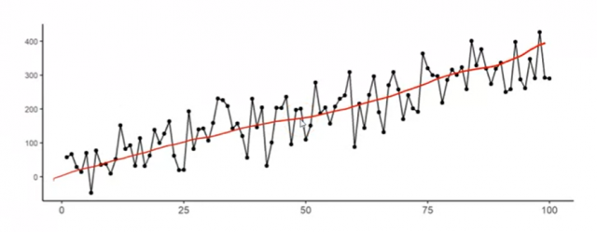
Trend
The picture shows an upward trend in the time-series data.

Slide 12
Seasonality
Seasonal data represent the presence of rhythmic patterns. Certain pattern repeatedly occurs at the same period or point every year (yearly, quarterly, monthly, etc)or in every season such as holidays or changes in weather.
Example - The sale of umbrellas increases during the rainy season, and air conditioners increase during summer. Apart from natural occurrences, man-made conventions like fashion, marriage season, festivals, etc., play a key role in contributing to seasonal trends.

Slide 13
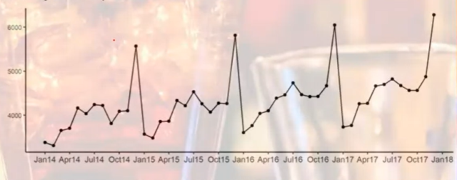
Seasonality
The picture shows the seasonality in the data.

Slide 14
Irregularity
It refers to data that are uncontrollable and inevitable. It occurs randomly, opposite to regular changes or occurrences, and does not associate with a pattern. These fluctuations are unpredictable and unexplainable. Forces like natural and man-made disasters can trigger irregular variations.

Slide 15
Circular
It represents a cyclical pattern composed of up and down movement. It may span more than one year and go from phase to phase to complete a cycle.
A business cycle is a significant example of a cyclic variation, denoted that a business goes through four stages in its life. Starting from the introduction, expansion, prosperity, and decline. How well the company can perform and stretch its phases depends on its performance.

Slide 16
Decomposition
Time series data can exhibit a variety of patterns, so it is often helpful to split a time series into components, each representing an underlying pattern category. This is what decompositional models do.
The decomposition of time series is a statistical task that deconstructs a time series into several components, each representing one of the underlying categories of patterns.
When we decompose a time series into components, we think of a time series as comprising three components: a trend component, a seasonal component, and residuals or ”noise” (containing anything else in the time series).

Slide 17
There are two main types of decomposition: decomposition based on rates of change and decomposition based on predictability.
Decomposition based on rates of change
This is an important time series analysis technique, especially for seasonal adjustment. It seeks to construct, from an observed time series, a number of component series (that could be used to reconstruct the original by additions or multiplications) where each of these has a certain characteristic or type of behavior.
If data shows some seasonality (e.g. daily, weekly, quarterly, yearly) it may be useful to decompose the original time series into the sum of three components:
Y(t) = S(t) + T(t) + R(t)
where S(t) is the seasonal component, T(t) is the trend-cycle component, and R(t) is the remainder component.

Slide 18
There are several techniques to estimate such a decomposition. The most basic one is called classical decomposition and consists in:
Estimating trend T(t) through a rolling mean
Computing S(t) as the average detrended series Y(t)-T(t) for each season (e.g. for each month)
Computing the remainder series as R(t)=Y(t)-T(t)-S(t)
Time series can also be decomposed into:
T_{t} , the trend component at time t, which reflects the long-term progression of the series. A trend exists when there is a persistent increasing or decreasing direction in the data.
C_{t}, the cyclical component at time t, which reflects repeated but non-periodic fluctuations. The duration of these fluctuations is usually of at least two years.
S_{t}, the seasonal component at time t, reflecting seasonality (seasonal variation). Seasonality occurs over a fixed and known time period (e.g., the quarter of the year, the month, or day of the week).
I_{t}, the irregular component (“residuals” or "noise") at time t, which describes random, irregular influences.

Slide 19
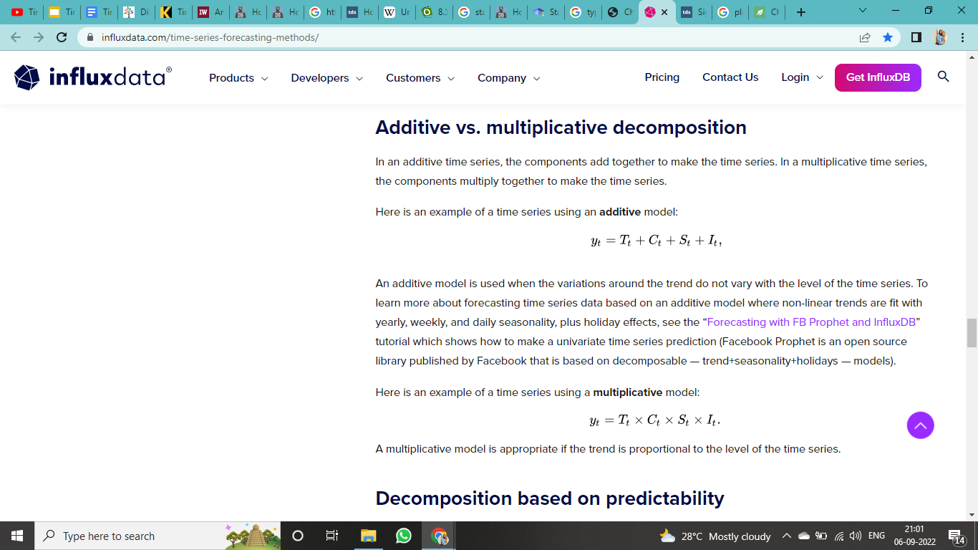
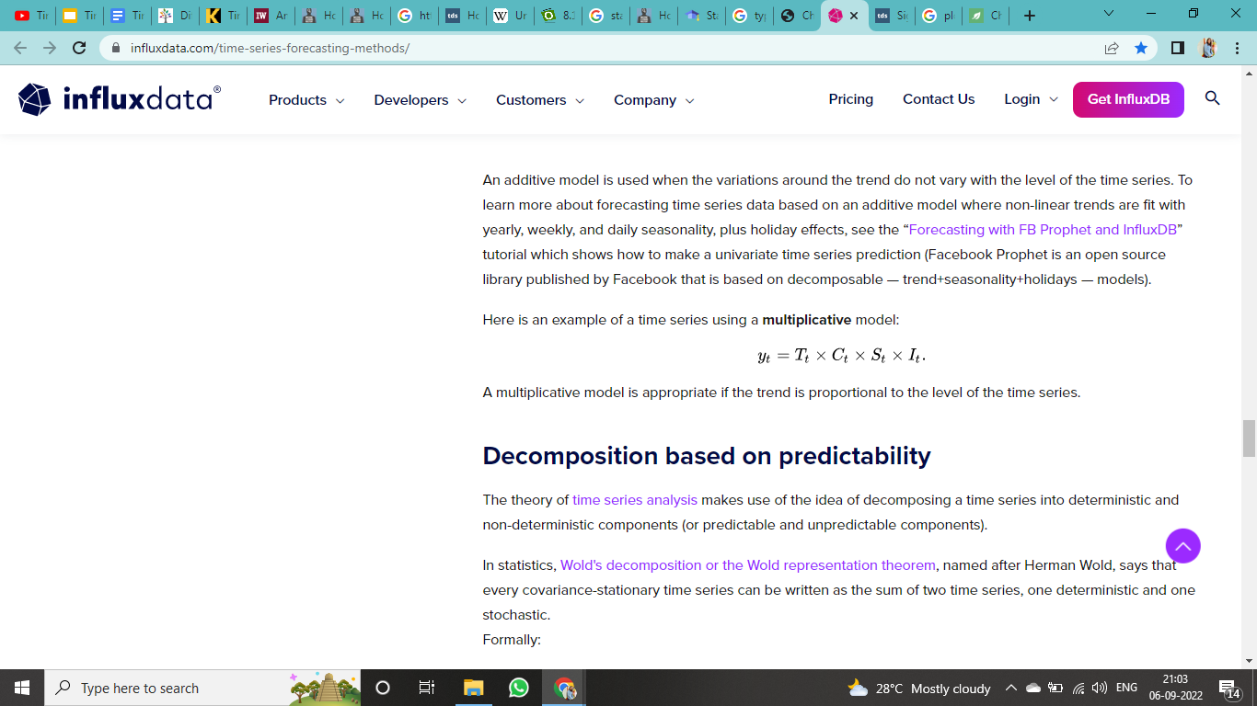
Additive & Multiplicative Decomposition
In an additive time series, the components add together to make the time series.
An additive model is used when the variations around the trend do not vary with the level of the time series.
Rather than a sum, the multiplicative decomposition argues that time series data is a function of the product of its components.
We can usually identify an additive or multiplicative time series from its variation. If the magnitude of the seasonal component changes with time, then the series is multiplicative. Otherwise, the series is additive

Slide 20
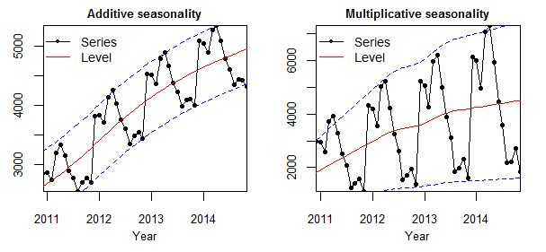
Here notice that the magnitude of the seasonal component — the difference between the maximum point of the series and the red line — is relatively constant from 2011 onward in the additive time series.
However, in the multiplicative series, the magnitude of the seasonal component grows as time increases.

Slide 21
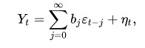
Decomposition based on predictability
The theory of time series analysis makes use of the idea of decomposing a time series into deterministic and non-deterministic components (or predictable and unpredictable components).
In statistics, every covariance-stationary time series can be written as the sum of two time series.
Formally:
Where:
Y_{t}is the time series being considered,
E_{t}is an uncorrelated sequence which is the innovation process to the process — that is, a white noise process that is input to the linear filter {b_{j}}
b is the possibly infinite vector of moving average weights (coefficients or parameters)
N_{t}is a deterministic time series, such as one represented by a sine wave.

Slide 22

Different Classes Of Time Series Data
There are two different classes of time-series data:
Stationary Data and
Non-stationary Data.

Slide 23
Stationary Data
Time series involves the use of data that are indexed by equally spaced increments of time (minutes, hours, days, weeks, etc.). Due to the discrete nature of time series data, many time series data sets have a seasonal and/or trend element built into the data.
The first step in time series modeling is to account for existing seasons (a recurring pattern over a fixed period of time) and/or trends (upward or downward movement in the data). Accounting for these embedded patterns is what we call making the data stationary.
A stationary time series is one whose properties do not depend on the time at which the series is observed. Thus, time series with trends, or with seasonality, are not stationary — the trend and seasonality will affect the value of the time series at different times. On the other hand, a white noise series is stationary — it does not matter when you observe it, it should look much the same at any point in time.

Slide 24
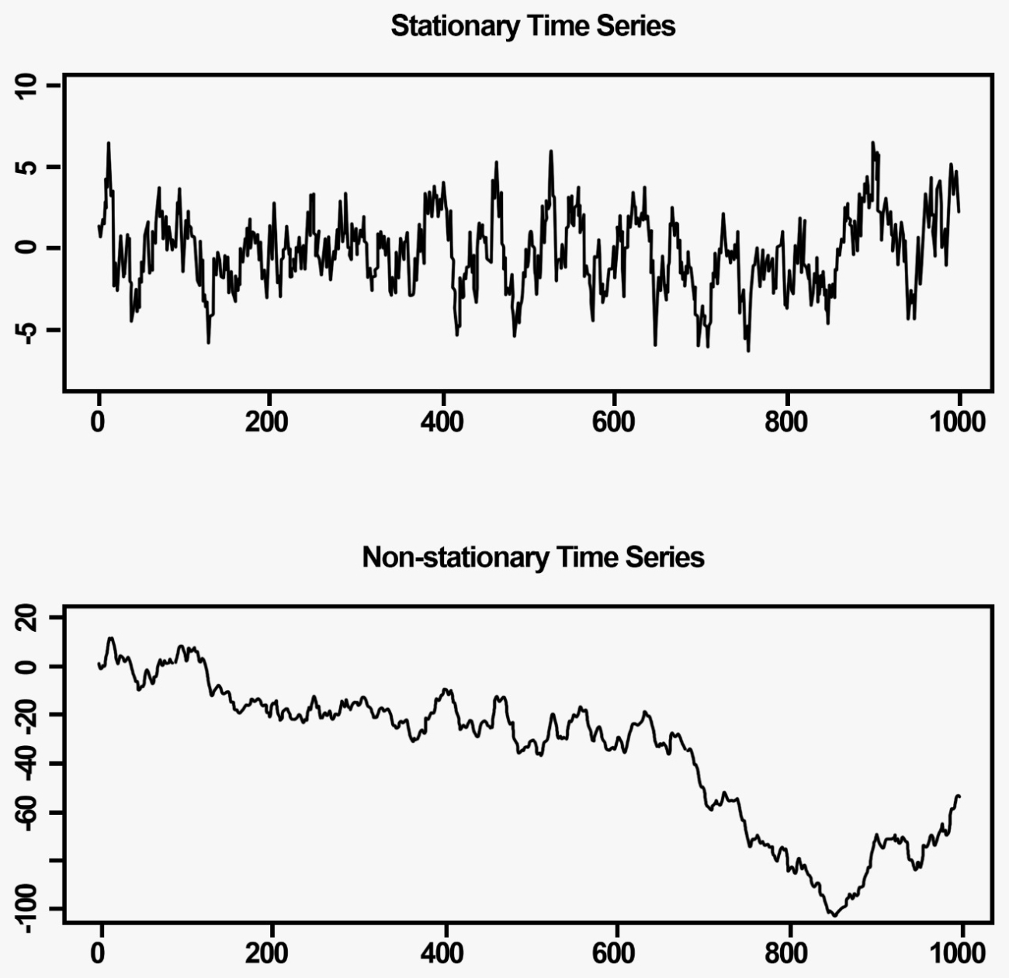
Some cases can be confusing — a time series with cyclic behaviour (but with no trend or seasonality) is stationary. This is because the cycles are not of a fixed length, so before we observe the series we cannot be sure where the peaks and troughs of the cycles will be.
In general, a stationary time series will have no predictable patterns in the long-term. Time plots will show the series to be roughly horizontal (although some cyclic behaviour is possible), with constant variance.

Slide 25
Properties of Stationary Data
Autocovariance that does not depends on time
Constant Variance
Constant Mean

Slide 26
Types of Stationarity
Strict stationarity - This means that the unconditional joint distribution of any moments (e.g. expected values, variances, third-order and higher moments) remains constant over time. This type of series is rarely seen in real-life practice.
First-order stationarity - These series have a mean constant over time. Any other statistics (like variance) can change at the different points in time.
Second-order stationarity (also called weak stationarity) - These time series have a constant mean and variance over time. Other statistics in the system are free to change over time. This is one of the most commonly observed series in real-life practice.
Trend stationarity - These series are the series with a trend. This trend when removed from the series leaves a stationary series.
Difference stationarity - These series are the series that need one or more differencing to become stationary. We will look into this in detail later in the article.

Slide 27
Non Stationary Data
A time series whose statistical properties change over time is called a non-stationary time series. Thus a time series with a trend or seasonality is non-stationary in nature. This is because the presence of trend or seasonality will affect the mean, variance and other properties at any given point in time.

Slide 28
How do we check stationarity?
Look at Plots: You can review a time series plot of your data and visually check if there are any obvious trends or seasonality.
Summary Statistics: You can review the summary statistics for your data for seasons or random partitions and check for obvious or significant differences i.e. - Rolling Statistics.
Statistical Tests: You can use statistical tests to check if the expectations of stationarity are met or have been violated i.e. - ADCF Test.

Slide 29
Rolling Statistics
Time Series Plot is used to observe various trends in the dataset over a period of time. In such problems, the data is ordered by time and can fluctuate by the unit of time considered in the dataset (day, month, seconds, hours, etc). When plotting the time series data, these fluctuations may prevent us to clearly gain insights about the peaks and troughs in the plot. So to clearly get value from the data, we use the rolling average concept to make the time series plot.
The rolling average or moving average is the simple mean of the last ‘n’ values. It can help us in finding trends that would be otherwise hard to detect. Also, they can be used to determine long-term trends. You can simply calculate the rolling average by summing up the previous ‘n’ values and dividing them by ‘n’ itself. But for this, the first (n-1) values of the rolling average would be Nan.

Slide 30
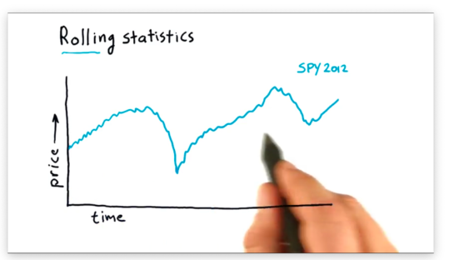
Rolling Statistics
Instead of computing a single statistic over an entire set of data, we compute a rolling statistic against a subset, or window, of that data, and we adjust the window with each new data point we encounter.
Let’s do a demonstration -
We have a graph of
SPY stock data.

Slide 31
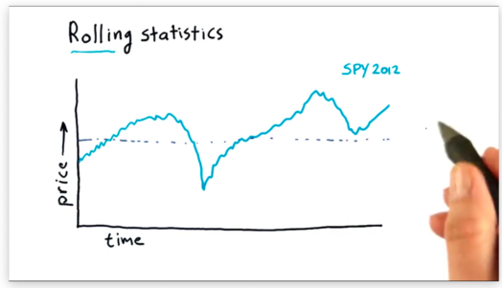
Rolling Statistics
We can compute the global mean of this data set, which is a single value described by the line below.

Slide 32
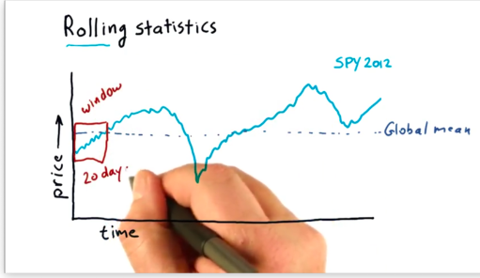
Rolling Statistics
We can also compute an n-day rolling mean. For a given day d, the n-day rolling mean is equal to the mean of the d - (n - 1) through d days. The window is the parameter n.
For example, we can compute a 20-day rolling
mean as follows. For a given day d, the 20-day
rolling mean is equal to the mean of the
d - 19 through d days. The window here is 20.

Slide 33
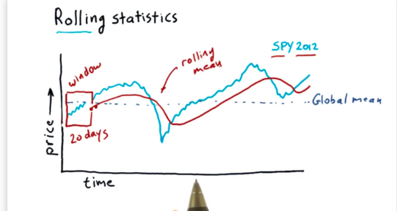
Rolling Statistics
We can calculate the 20-day rolling mean for day d' = d + 1 as the mean of the d - 18 through d + 1 days. Generally, we can imagine "sliding" the window through the data set and computing the rolling mean at each data point.
Note that our sliding mean calculations form a curve that begins 20 data points after the beginning of the SPY data.

Slide 34
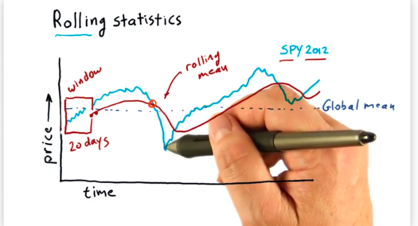
Rolling Statistics
We can see that this rolling mean line follows the day-to-day values of the SPY price data, but it lags slightly as it has to incorporate the past twenty days into its calculation.
The rolling mean is referred to as a simple moving average (SMA) by technical analysts. Technical analysts utilize SMAs by looking at points where the price crosses over the SMA.

Slide 35
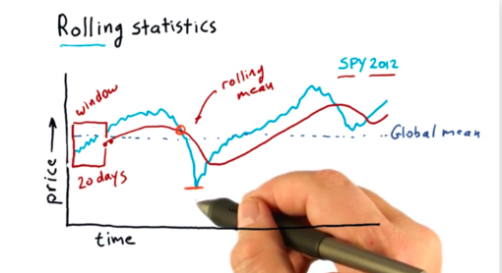
Rolling Statistics
A hypothesis that many technical analysts abide by is that the rolling mean may be a good representation of the true, underlying price of the stock and that significant deviations from that mean eventually result in a return to the mean.
As a result, if you can spot significant deviations from the mean, you might be able to spot a buying opportunity.

Slide 36
Summary - Rolling Statistics
Why rolling statistics is used?
Rolling statistics are useful for finding long-term trends otherwise disguised by occasional fluctuations.
For instance, if your company sells ice, you might notice a fluctuation upwards on hot days. If the temperature in your area fluctuates often, your data might become difficult to track.

Slide 37
Augmented Dickey Fuller Test(ADFT)
Augmented Dickey Fuller test (ADF Test) is a common statistical test used to test whether a given Time series is stationary or not. It is one of the most commonly used statistical test when it comes to analyzing the stationary of a series.
In world of data science so Dickey is another statistical test for checking stationarity.We take a the null hypothesis which says time
series is non stationary and once we perform this test we will get a result which comprises of a test statistic and some critical values for different
confidence level.So it says that if the test statistic is less than the critical value we can reject the null hypothesis and say that the series
is stationary.

Slide 38
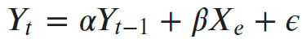
What is a Unit Root Test ?
The ADF test belongs to a category of tests called ‘Unit Root Test’, which is the proper method for testing the stationarity of a time series.
So what does a ‘Unit Root’ mean?
Unit root is a characteristic of a time series that makes it non-stationary. Technically speaking, a unit root is said to exist in a time series of the value of alpha = 1 in the below equation.
where, Yt is the value of the time series at time ‘t’ and Xe is an exogenous variable (a separate explanatory variable, which is also a time series).
What does this mean to us?
The presence of a unit root means the time series is non-stationary. Besides, the number of unit roots contained in the series corresponds to the number of differencing operations required to make the series stationary.

Slide 39
Augmented Dickey Fuller Test(ADFT)
Null Hypothesis (H0): If failed to be rejected, it suggests the time series has a unit root, meaning it is non-stationary. It has some time dependent structure.
Alternate Hypothesis (H1): The null hypothesis is rejected; it suggests the time series does not have a unit root, meaning it is stationary. It does not have time-dependent structure.
We interpret this result using the p-value from the test. A p-value below a threshold (such as 5% or 1%) suggests we reject the null hypothesis (stationary), otherwise a p-value above the threshold suggests we fail to reject the null hypothesis (non-stationary).
p-value > 0.05: Fail to reject the null hypothesis (H0), the data has a unit root and is non-stationary.
p-value <= 0.05: Reject the null hypothesis (H0), the data does not have a unit root and is stationary.

Slide 40
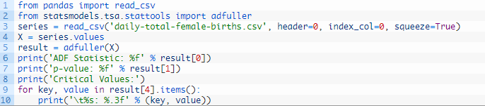
Augmented Dickey Fuller Test(ADFT)
Below is an example of calculating the Augmented Dickey-Fuller test on the Daily Female Births dataset. The statsmodels library provides the adfuller() function that implements the test.

Slide 41
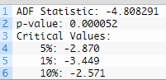
Augmented Dickey Fuller Test(ADFT)
Running the example prints the test statistic value of -4. The more negative this statistic, the more likely we are to reject the null hypothesis (we have a stationary dataset).
As part of the output, we get a look-up table to help determine the ADF statistic. We can see that our statistic value of -4 is less than the value of -3.449 at 1%.
This suggests that we can reject the null hypothesis with a significance level of less than 1% (i.e. a low probability that the result is a statistical fluke).
Rejecting the null hypothesis means that the process has no unit root, and in turn that the time series is stationary or does not have time-dependent structure.

Slide 42
Why Stationarity Is Important ?
If a distribution is not stationary, then it becomes tough to model. Algorithms build relationships between inputs and outputs by estimating the core parameters of the underlying distributions.
When these parameters are all time-dependent, algorithms will face different values at each point in time. And if the time series is granular enough (such as minutes or seconds frequencies), models may even end up with more parameters than actual data.
This type of variable relationship between inputs and outputs will seriously compromise the decision function of any model. If the relationship keeps changing through time, models end up using an outdated relationship or one that does not contribute to its predictive power.
Therefore, you must dedicate a certain amount of time to detecting non-stationarity and removing its effects during your workflow.

Slide 43
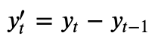
Differencing
Differencing is the method we use to transform non-stationary data to stationary data. The most basic differencing idea would be first-order differencing, where we are essentially calculating the difference between the consecutive observations.
In some cases, we are able to obtain stationary data after the first order differencing itself. However, in some other cases, we might need to do further differentiation like a second-order differencing (i.e. to calculate the difference of the first order differencing results), and the process could go on and on.
The idea of obtaining stationary data is the foundation of ARIMA-based models, or more specifically, it ties closely to the I(Integration) portion of the ARIMA model.

Slide 44

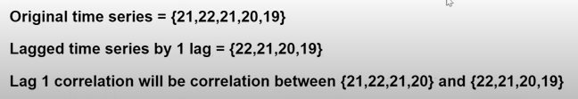
What is Lagged Series ?
Lagging a time series means to shift its values forward one or more time steps, or equivalently, to shift the times in its index backward one or more steps. In either case, the effect is that the observations in the lagged series will appear to have happened later in time.
For ex -
By lagging a time series, we can make its past values appear contemporaneous with the values we are trying to predict (in the same row, in another words). This makes lagged series useful as features for modeling serial dependence.

Slide 45
Different Types of Time Series Model
Autoregression (AR),
Moving Average (MA),
Autoregressive Moving Average (ARMA), Autoregressive Integrated Moving Average (ARIMA), and
Seasonal Autoregressive Integrated Moving-Average (SARIMA).

Slide 46
Plotting ACF & PACF
Before studying about different kind of Time series forecasting model , we need to understand the ACF and PACF plotting and why we feed p and q respectively to our ARIMA model .
ACF is an (complete) auto-correlation function which gives us values of auto-correlation of any series with its lagged values. We plot these values along with the confidence band and get an ACF plot.
In simple terms, it describes how well the present value of the series is related with its past values. A time series can have components like trend, seasonality, cyclic and residual. ACF considers all these components while finding correlations hence it’s a ‘complete auto-correlation plot’.

Slide 47
Plotting ACF & PACF
PACF is a partial auto-correlation function. So instead of finding correlations of present with lags like ACF, it finds correlation of the residuals (which remains after removing the effects which are already explained by the earlier lag(s)) with the next lag value hence ‘partial’ and not ‘complete’ as we remove already found variations before we find the next correlation.
So if there is any hidden information in the residual which can be modeled by the next lag, we might get a good correlation and we will keep that next lag as a feature while modeling.
Remember while modeling we don’t want to keep too many features which are correlated as that can create multicollinearity issues. Hence we need to retain only the relevant features.

Slide 48
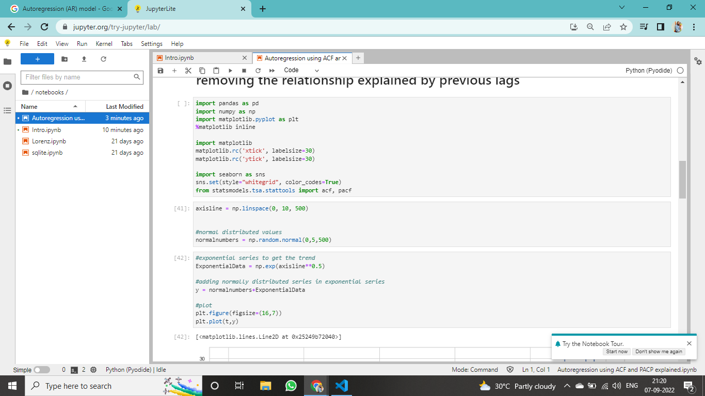
Plotting ACF and PACF for an AR model
We have imported all the necessary libraries and then took 500 numbers starting from 0 on X- axis .
We have given few random numbers also.

Slide 49
Plotting ACF and PACF for an AR model
We are taking the exponential series
And then plotting a time series.
Exponential Time Series - It is a time series forecasting method for univariate data without a trend or seasonality.

Slide 50
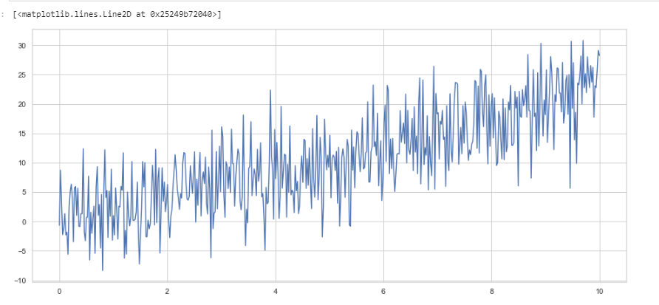
Plotting ACF and PACF for an AR model
This is how our time series look like .

Slide 51
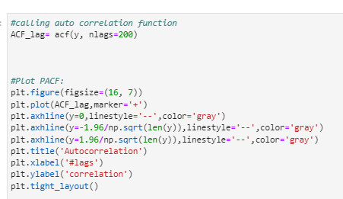
Plotting ACF and PACF for an AR model
Now we are plotting ACF for that time series.

Slide 52
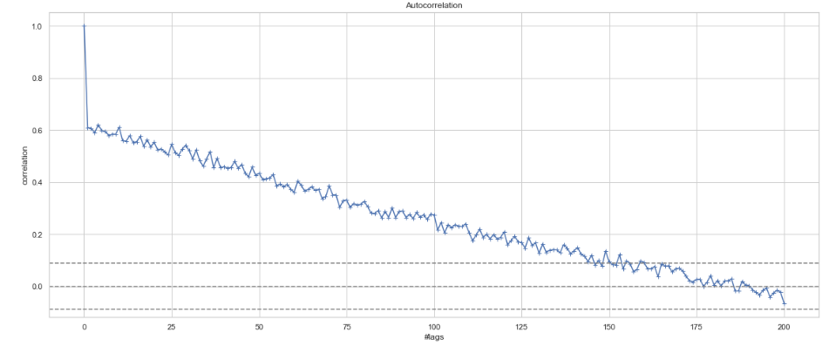
Plotting ACF and PACF for an AR model
Now we are plotting ACF for that time series.

Slide 53
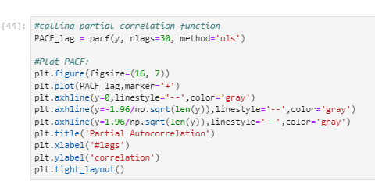
Plotting ACF and PACF for an AR model
Now we are plotting PACF for that time series.

Slide 54
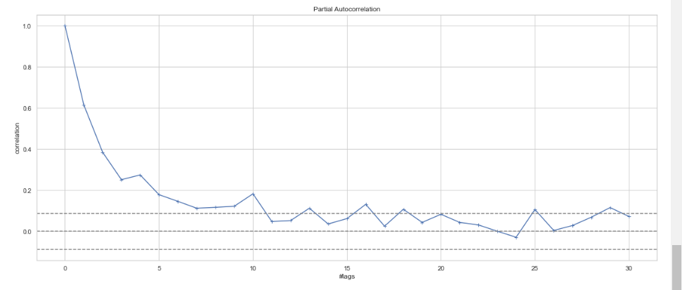
Plotting ACF and PACF for an AR model
Now we are plotting PACF for that time series.

Slide 55
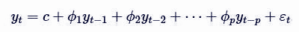
AR
Auto regressive (AR) process , a time series is said to be AR when present value of the time series can be obtained using previous values of the same time series i.e the present value is weighted average of its past values.
Stock prices and global temperature rise can be thought of as an AR processes.
The AR process of an order p can be written as,
Where ϵt is a white noise,
y’t-₁ and y’t-₂ are the lags.
Order p is the lag value after which PACF plot crosses the upper confidence interval for the first time. These p lags will act as our features while forecasting the AR time series.

Slide 56
AR
Autoregression model needed no more information, but it must comply with the following two conditions.
It must be autocorrelated; if autocorrelation coefficient () is less than 0.5, then it should not be used to predict the results which will be highly inaccurate.
Autoregression model only applies to the forecast and its early-related phenomenon, which is influenced by its own historical factors .

Slide 57
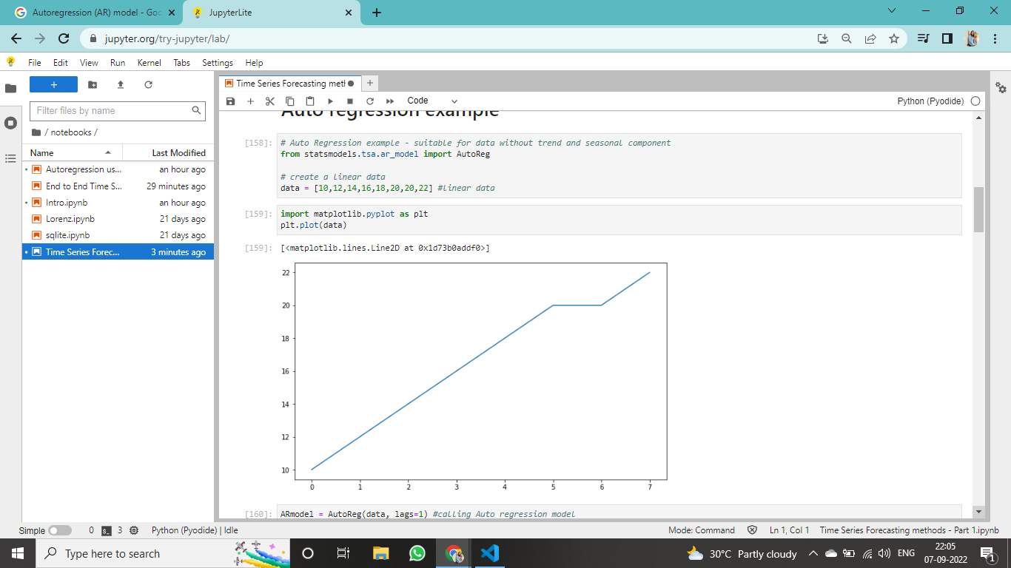
Implementation in Python

Slide 58
Implementation in Python

Slide 59
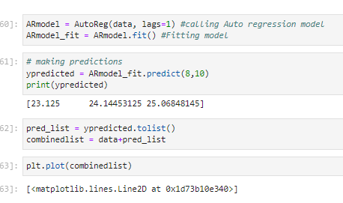
Implementation in Python

Slide 60
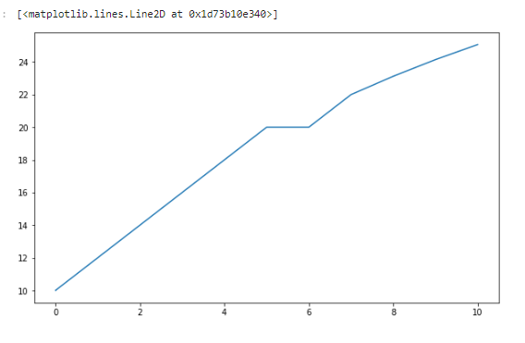
Implementation in Python

Slide 61
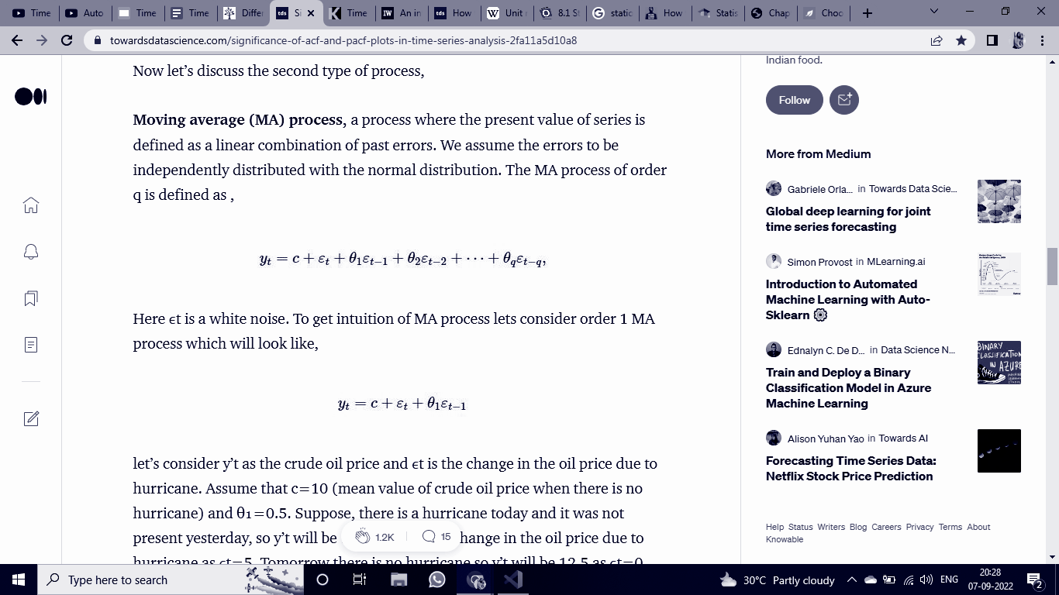
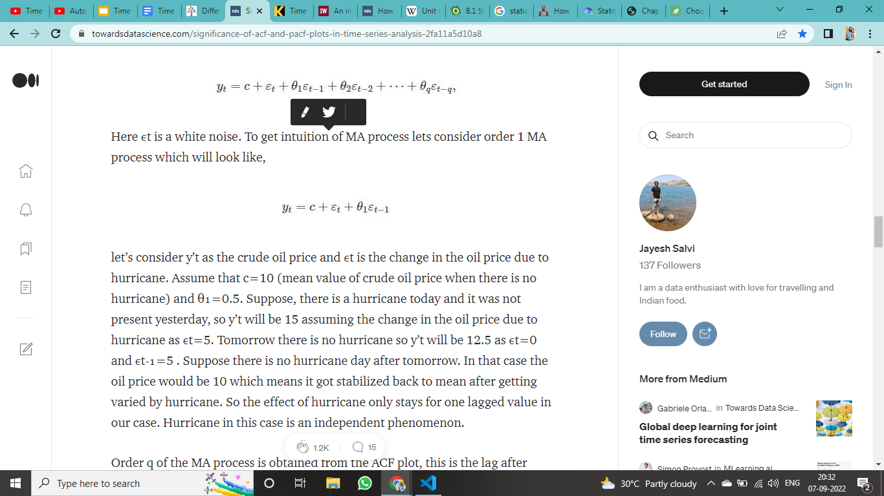
MR
Moving average (MA) process, a process where the present value of series is defined as a linear combination of past errors. We assume the errors to be independently distributed with the normal distribution. The MA process of order q is defined as ,
Here ϵt is a white noise. To get intuition of MA process lets consider order 1 MA process which will look like,

Slide 62
We can take an example
Lets consider Y_{t} as the crude oil price and E_{t} is the change in the oil price due to hurricane. Assume that c=10 (mean value of crude oil price when there is no hurricane) and θ₁=0.5.
Suppose, there is a hurricane today and it was not present yesterday, so Y_{t} will be 15 assuming the change in the oil price due to hurricane asE_{t} =5. Tomorrow there is no hurricane so Y_{t} will be 12.5 as E_{t}=0 andE_{t-1} =5 .
Suppose there is no hurricane day after tomorrow. In that case the oil price would be 10 which means it got stabilized back to mean after getting varied by hurricane. So the effect of hurricane only stays for one lagged value in our case. Hurricane in this case is an independent phenomenon.

Slide 63
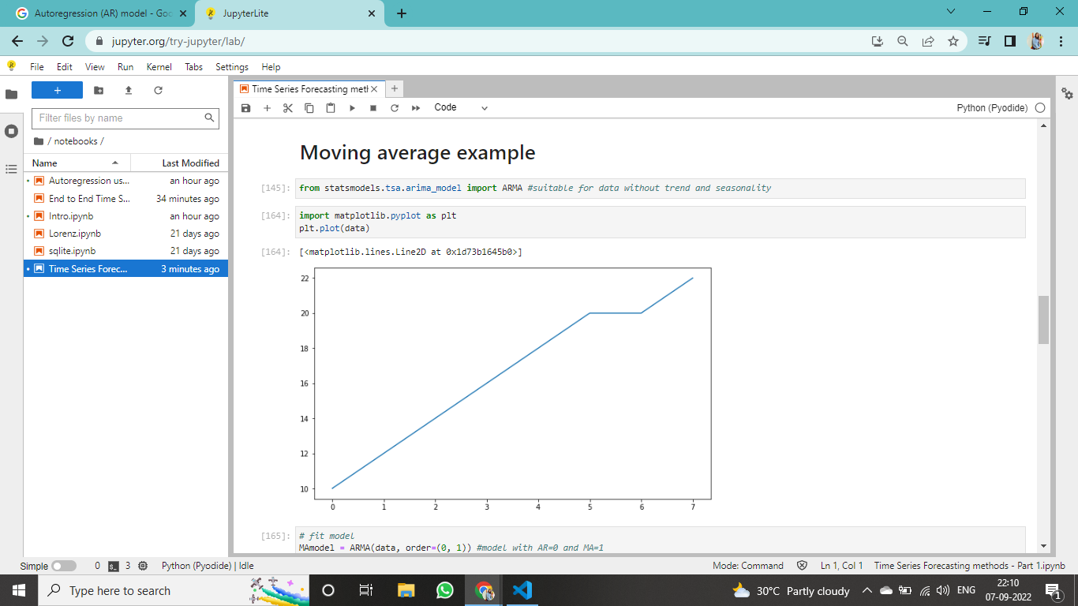
Implementation in Python

Slide 64
Implementation in Python

Slide 65
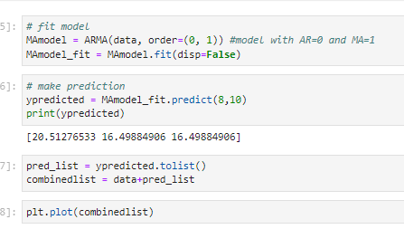
Implementation in Python

Slide 66
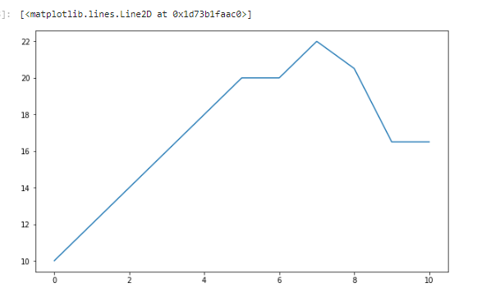
Implementation in Python

Slide 67
AR vs MA
Agency values
Mission
Vision
Jupiter is a gas giant and the biggest planet
Mercury is the closest planet to the Sun
Venus is the second planet from the Sun
Neptune is the farthest planet from the Sun
Despite being red, Mars is a cold place
Saturn is a gas giant and has several rings

Slide 68
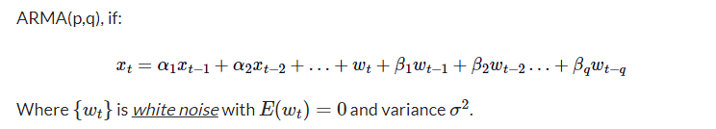
ARMA
ARMA (Auto Regressive Moving Average) Model
This is a model that is combined from the AR and MA models. In this model, the impact of previous lags(of AR) along with the residuals(of MA) is considered for forecasting the future values of the time series.
Often this model is referred to as the ARMA(p,q) model; where:
p is the order of the autoregressive polynomial,
q is the order of the moving average polynomial.

Slide 69
ARMA
Why do we need ARMA?
Applications. ARMA is appropriate when a system is a function of a series of unobserved shocks (the MA or moving average part) as well as its own behavior. For example, stock prices may be shocked by fundamental information as well as exhibiting technical trending and mean-reversion effects due to market participants.
Why ARMA model is particularly useful for financial time series data?
ARMA models are of particular use for financial series due to their flexibility. They are fairly simple to estimate, can often produce reasonable forecasts, and most importantly, they require no knowledge of any structural variables that might be required for more “traditional” econometric analysis.

Slide 70
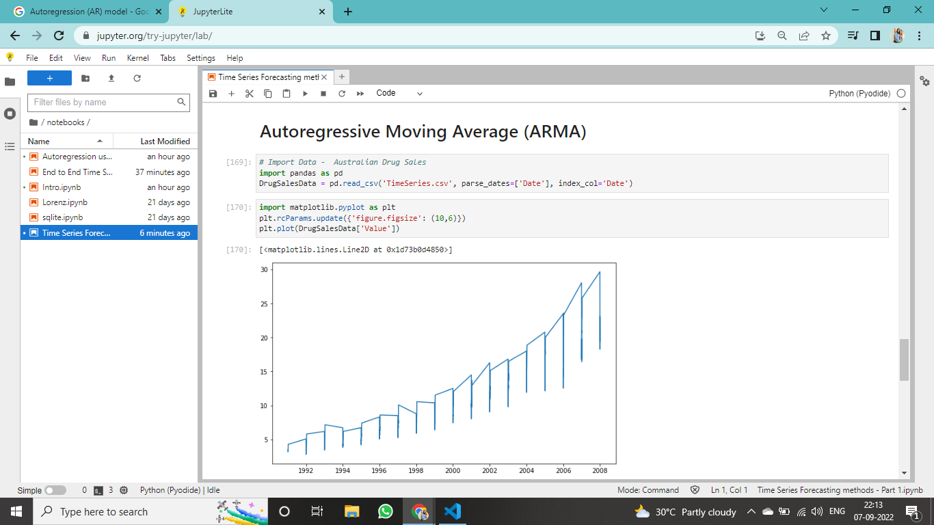
Implementation in Python
Note -
Let's assume that we consider only 1 significant value from the AR model and likewise 1 significant value from the MA model. So the ARMA model will be obtained from the combined values of the other two models will be of the order of ARMA(1,1).
Imported library and loaded DrugSales Data .

Slide 71
Implementation in Python

Slide 72
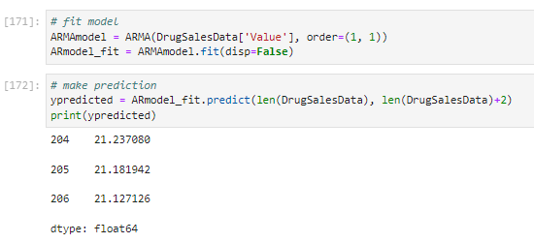
Implementation in Python
When AR and MA are combined , it predict the range of 21 and observing our previous graph of original data , you can say its a good prediction.

Slide 73
ARIMA
The ARIMA model is quite similar to the ARMA model other than the fact that it includes one more factor known as Integrated( I ) i.e. differencing which stands for I in the ARIMA model. So in short ARIMA model is a combination of a number of differences already applied on the model in order to make it stationary, the number of previous lags along with residuals errors in order to forecast future values.
ARIMA models include parameters to account for season and trend (like using dummy variables for days of the week and differencing), but also allow for the inclusion of autoregressive and/or moving average terms to deal with the autocorrelation imbedded in the data. By using the appropriate ARIMA model, we can further increase the accuracy of the forecast.

Slide 74
Difference between ARIMA & ARMA?
The two models share many similarities. In fact, the AR and MA components are identical, combining a general autoregressive model AR(p) and general moving average model MA(q). AR(p) makes predictions using previous values of the dependent variable. MA(q) makes predictions using the series mean and previous errors.
What sets ARMA and ARIMA apart is differencing. An ARMA model is a stationary model; If your model isn’t stationary, then you can achieve stationarity by taking a series of differences. The “I” in the ARIMA model stands for integrated; It is a measure of how many non-seasonal differences are needed to achieve stationarity. If no differencing is involved in the model, then it becomes simply an ARMA.
A model with a dth difference to fit and ARMA(p,q) model is called an ARIMA process of order (p,d,q).

Slide 75
Applications of ARIMA
In business and finance, the ARIMA model can be used to forecast future quantities (or even prices) based on historical data. Therefore, for the model to be reliable, the data must be reliable and must show a relatively long time span over which it’s been collected. Some of the applications of the ARIMA model in business are listed below:
Forecasting the quantity of a good needed for the next time period based on historical data.
Forecasting sales and interpreting seasonal changes in sales
Estimating the impact of marketing events, new product launches, and so on.

Slide 76
Working of ARIMA
To understand how an ARIMA model functions, there are three terms within the name that you will need to better understand:
AutoRegressive - AR(p) is a regression model with lagged values of y, until p-th time in the past, as predictors. Here, p = the number of lagged observations in the model, ε is white noise at time t, c is a constant and φs are parameters.

Slide 77
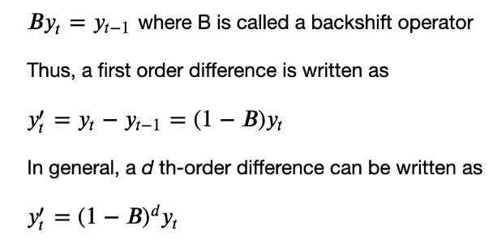
Working of ARIMA
Integrated I(d) - The difference is taken d times until the original series becomes stationary. A stationary time series is one whose properties do not depend on the time at which the series is observed.

Slide 78
Working of ARIMA
Moving average MA(q) - A moving average model uses a regression-like model on past forecast errors. Here, ε is white noise at time t, c is a constant, and θs are parameters
Combining all of the three types of models above gives the resulting ARIMA(p,d,q) model.

Slide 79
Pros of ARIMA
Only requires the prior data of a time series to generalize the forecast.
Performs well on short term forecasts.
Models non-stationary time series.

Slide 80
Cons of ARIMA
Difficult to predict turning points.
There is quite a bit of subjectivity involved in determining (p,d,q) order of the model.
Computationally expensive.
Poorer performance for long term forecasts.
Cannot be used for seasonal time series.
Less explainable than exponential smoothing.

Slide 81
When not to use ARIMA
Some of the points that can tell us when not to use the ARIMA model are as follows :
With non-stationary data
One of the most important factors that we need to consider while applying the ARIMA model in the time series is that the data we are using should not be stationary. In such a situation we are required to use other models like ARMA. The stationarity of the data can be checked using the Augmented Dickey-Fuller test in which if the p-value is more than the significance level then we consider time series data as nonstationary and if it is not then the time series is stationary.

Slide 82

We should apply this model after knowing about the stationarity of the time series. The reason behind applying with non-stationary data is the integration part of the model that applies the differencing step and with stationary data, ARIMA can not be applied. By the differencing, the model makes the time series stationary.

Slide 83
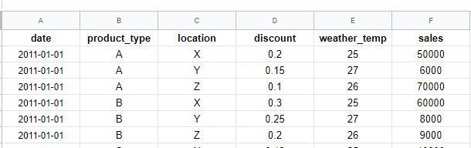
When not to use ARIMA
2. With multivariate data
The ARIMA model is designed to use the univariate time series data so if the time series is having only one variable we can use it otherwise we are required to choose models from the VARMA family. However, we can perform modelling using the variables one by one manner but if the correlation is there between the variables of the time series then we can not use it to make proper results

Slide 84
When not to use ARIMA
3. Need of Explainability
If we need explainability in modelling we should not use the ARIMA model because its nature is not very explainable. In such situations, we can choose models like exponential smoothing, moving average (MA) etc. the reason behind the less explainability is the combination of three modelling procedures makes it difficult to interpret models with higher values.

Slide 85
When not to use ARIMA
4. Computational constraints
With very long time series this model becomes very expensive and slow in computation. The reason for being weak at computation is the moving average and integration part of the model because applying differencing more than once is also a high computational process and the moving average is the linear combination of the errors. Also sometimes they can perform poorly if we don’t have prior knowledge about choosing the right value of parameters.

Slide 86
When not to use ARIMA
5. Continuity of the data
With the ARIMA model, it becomes compulsory to record data points in a regular time interval. If there are missing values in the time series then this model can not be applied to the time series. The reason behind this problem is we are applying a moving average which moves the window through the time series and finds the trend of the time series. If the trend is broken at a point, it stops working and can cause the models to not perform.

Slide 87
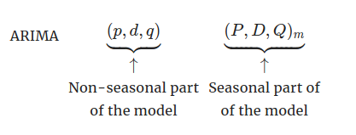
SARIMA
SARIMA stands for Seasonal-ARIMA and it includes seasonality contribution to the forecast. The importance of seasonality is quite evident and ARIMA fails to encapsulate that information implicitly.
The Autoregressive (AR), Integrated (I), and Moving Average (MA) parts of the model remain as that of ARIMA. The addition of Seasonality adds robustness to the SARIMA model. It’s represented as:
Similar to ARIMA, the P,D,Q values for seasonal parts of the model can be deduced from the ACF and PACF plots of the data.

Slide 88
Use of SARIMA
The SARIMA model can be used to forecast demand for a product or service over the course of a year. The model takes into account sales data from previous years as well as seasonality (e.g., holiday sales). SARIMA can also be used to forecast other time-series data, such as stock prices or weather patterns.
This models can be used to forecast short-term or long-term trends in data. SARIMA models are generally considered to be more accurate than other types of time-series forecasting models, such as ARIMA models. SARIMA models are also relatively easy to interpret and use.

Slide 89
Pros of ARIMA & SARIMA
Easy to understand and interpret: The one thing that your fellow teammates and colleagues would appreciate is the simplicity and interpretability of the models. Focusing on both of these things while also maintaining the quality of the results will help with presentations with the stakeholders.
Limited variables: There are fewer hyperparameters so the config file will be easily maintainable if the model goes into production.

Slide 90
Cons of ARIMA & SARIMA
Exponential time complexity: When the value of p and q increases there are equally more coefficients to fit hence increasing the time complexity manifold if p and q are high. This makes both of these algorithms hard to put into production and makes Data Scientists look into Prophet and other algorithms. Then again, it depends on the complexity of the dataset too.
Complex data: There can be a possibility where your data is too complex and there is no optimal solution for p and q. Although highly unlikely that ARIMA and SARIMA would fail but if this occurs then unfortunately you may have to look elsewhere.
Amount of data needed: Both the algorithms require considerable data to work on, especially if the data is seasonal. For example, using three years of historical demand is likely not to be enough (Short Life-Cycle Products) for a good forecast.

Slide 91
Approach for Choosing Best p and q
Sometimes it’s very hard and time expensive to find the right order of p and q for the ARMA model by analyzing ACF and PACF plots
In Python the auto ARIMA method itself will generate the optimal and parameters, which would be suitable for the data set to provide better forecasting. The high-level logic behind that is the same as the logic behind hyperparameter tuning of any other machine learning model. We need to try some combinations of p and q parameters and compare results using a validation set.
Since our search space is not big, usually values p and q are not higher than 10, we can apply a popular technique for hyperparameter optimization called grid search. Grid search is simply an exhaustive search through a manually specified subset of the hyperparameter space of a learning algorithm. Basically, it means that this method will try each combination of and from the specified subset that we provided.
Also, in order to find the best combination of p and q, we need to have some objective function that will measure model performance on a validation set. Usually, we can use Akaike Information Criteria (AIC) and (BIC) Bayesian Information Criteria for that purpose. The lower the value of these criteria, the better the model is.

Slide 92
Before moving forward we need to learn about Data smoothing in Time series
Smoothing techniques are kinds of data preprocessing techniques to remove noise from a data set. This allows important patterns to stand out.
In market analysis, smoothed data is preferred because it generally identifies changes in the economy compared to unsmoothed data.
The idea behind data smoothing is that it can identify simplified changes to help predict different trends and patterns. It acts as an aid for statisticians or traders who need to look at a lot of data.
Time series smoothing techniques are broadly used in economics, meteorology, ecology, and other fields dealing with data collected over time. Smoothing temporal data often reveals longer-term trends or cycles while smoothing over noise and short-term fluctuations

Slide 93
Data smoothing in Time series
We are going to discuss four major smoothing technique-
1. Moving average smoothing
2. Exponential smoothing
3. Double exponential smoothing
4. Triple exponential smoothing

Slide 94
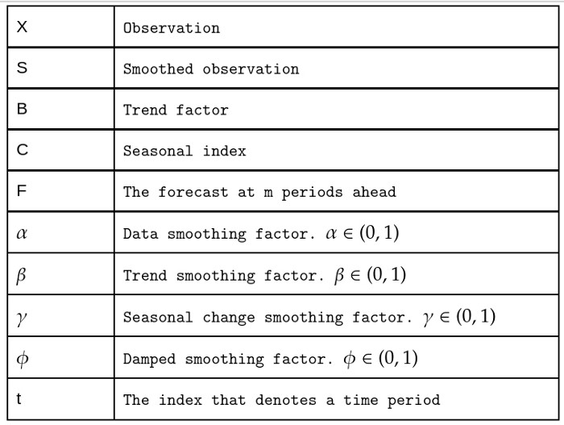
Some symbols used to represent in coming slides -

Slide 95
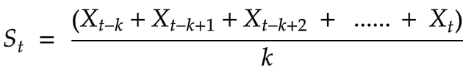
Data smoothing in Time series
Moving average smoothing -
It is a simple and common type of smoothing used in time series analysis and forecasting. Here time series derived from the average of last kth elements of the series.
Where ,
S- Smoothed Observation
X- Observations
k - element of the series
t-the index that denote time series

Slide 96
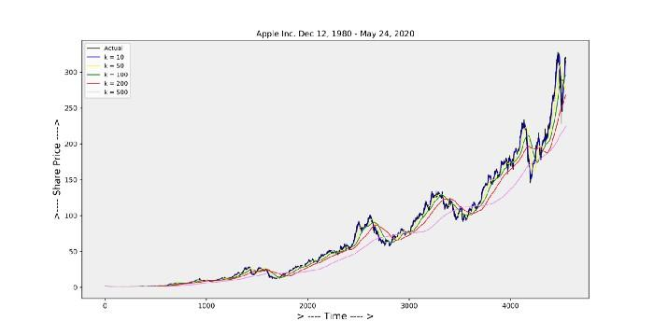
Data smoothing in Time series
In this example, we can see that smaller values of k lead to more variation in the result, and a larger value of k leads to more smoothness.

Slide 97
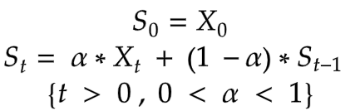
Data smoothing in Time series
Exponential smoothing -
Exponential smoothing is a weighted moving average technique. In the moving average smoothing the past observations are weighted equally, In this case smoothing is done by assigning exponentially decreasing weights to the past observations.
It fit for the data having not trends and no seasonality .
In the above equation, we can see that (1−α) is multiplied by the previously expected value St-1 which is derived using the same formula. which makes the expression recursive and if you were to write it all out on paper you would quickly see that (1−α) is multiplied by itself again and again. And this is why this method is called exponential.

Slide 98
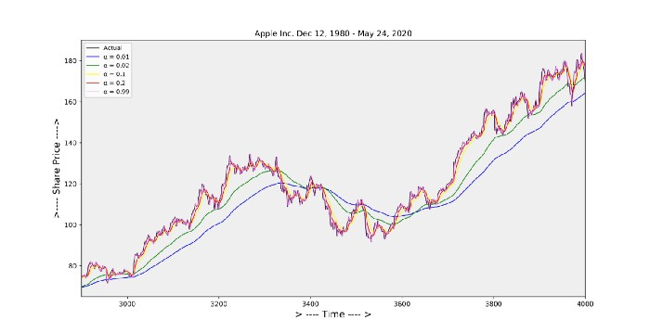
Data smoothing in Time series
Exponential smoothing graph

Slide 99
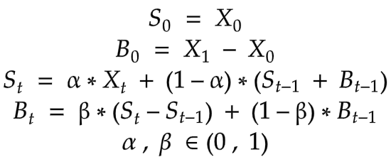
Data smoothing in Time series
Double exponential smoothing-
Single Smoothing does not excel in the data when there is a trend. This situation can be improved by the introduction of a second equation with a second constant β.
t is suitable to model the time series with the trend but without seasonality.
Here it is seen that α is used for smoothing the level and β is used for smoothing the trend.
( Note : Level of the series – the average value for a specific time period.)

Slide 100
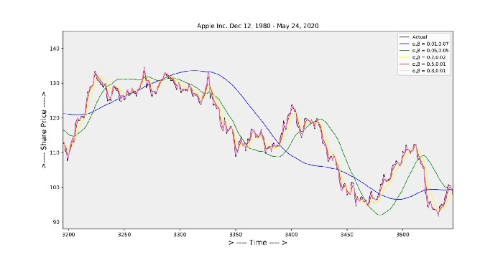
Data smoothing in Time series
Double Exponential smoothing graph

Slide 101
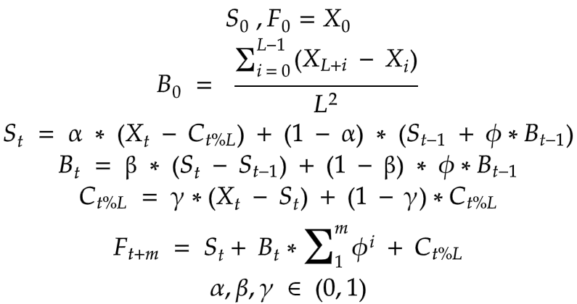
Data smoothing in Time series
Triple exponential smoothing -
It is also called as Holt-winters exponential smoothing .It is used to handle the time series data containing a seasonal component.
Double smoothing will not work in case of data contain seasonality. So that for smoothing the seasonality a third equation is introduced.
In the above ϕ is the damping constant. α, β, and γ must be estimated in such a way that the MSE(Mean Square Error) of the error is minimized.

Slide 102
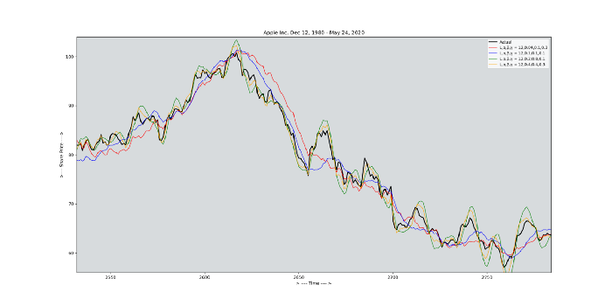
Data smoothing in Time series
Triple Exponential smoothing graph

Slide 103
Benefits of Data Smoothing
Data smoothing methods are easy to understand and implement. It can help in identifying trends in businesses, financial securities, and the economy.
Data smoothing can help expose patterns in complicated data. It assists in the prediction of the usual direction of the next observed data point. If users do not need certain data points, data smoothing eliminates the data points if they are of no interest to the user.
It also helps to generate smooth graphs that depict trends and patterns.

Slide 104
Limitation of Data Smoothing
Data smoothing does not necessarily offer an interpretation of the themes or patterns it helps to recognize. It can also contribute to certain data points being overlooked by focusing on others.
Sometimes, data smoothing may eliminate the usable data points. It may lead to incorrect forecasts if the data set is seasonal and not completely be reflective of the reality produced by the data points. Moreover, data smoothing can be prone to considerable disruption from the outliers in the data.

Slide 105
Time Series Forecasting using Statsmodel library
Time Series analysis has a wide range of applications. While it seems quite easy to just directly apply some of the popular time series analysis frameworks like the ARIMA model, or even the Facebook Prophet model, it is always important to know what is going on behind the function calls.
we are going to use a dataset of liquor store retail sales data across the US ranging from 1992 to 202 ,it also covers the Covid time period, which is interesting to see if there are significant impacts on retail sales.

Slide 106
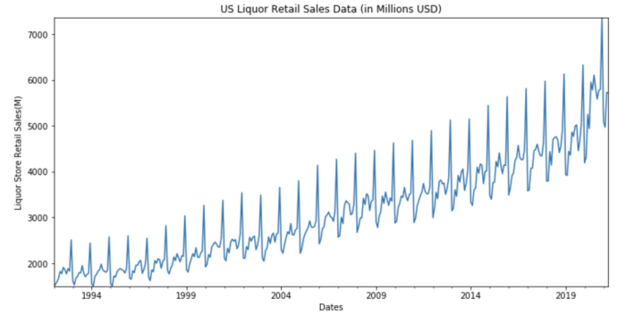
Implementation of statsmodel
Here we could see a clear pattern on yearly basis in this time-series data. Generally, we are seeing the liquor sales peaking at the year-end, which is expected since Christmas and New Year is generally the time when people are having gatherings, thus the demands on Liquor go up.

Slide 107
Implementation of statsmodel
ETS(Error/Trend/Seasonality) Model
As the name suggests, the ETS model describes the time series data by decomposing the data into 3 components: trend, seasonality, and errors. Statsmodels library provides a handy function call to separate out these elements, giving a direct view of how different elements contributing to the overall behaviors.
The function usage for ETS Model is actually quite straightforward, the only parameter to pay attention to is the model param. There are 2 types of models available, which are
“additive” and “multiplicative” respectively.
Additive: applicable when the trend and seasonality components are constant (or linear)over time.
Multiplicative: applicable when the trend increasing or decreasing is at a non-linear rate.

Slide 108
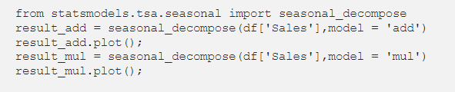
Implementation of statsmodel
How would you know if the trend is increasing in the linear or non-linear rate?
So in reality, the best approach is just to try both and compare their performance later on.

Slide 109

Seasonal_decompose with model = ‘add’

Slide 110

Seasonal_decompose with model = ‘mul’

Slide 111
Implementation of statsmodel
From the two plots above, while the trend and seasonal plots look similar, the residual plots if more flat when model = ‘mul’ is chosen. Therefore, in our particular case, we shall go with the multiplicative model moving forward.

Slide 112
Implementation of statsmodel
EWMA(Exponential Weighted Moving Average) Models
We have just learned from the ETS model that the key elements to describe a time series data is as follows:
Level: describing the average values in time series data.
Trend: describing the increasing or decreasing trend in data.
Seasonality: The repeating cycles in data, could be monthly or weekly, etc depending on the granular level of data
Noise: The random variations in the time series data.

Slide 113

Implementation of statsmodel
Now let's target the “Level” element first — how to describe the average values of a time series effectively?
The most straightforward idea might be taking the simple moving averages based on a window size (i.e. how many data points to look at when taking the averages).
To achieve that we can simply use the .rolling() method from pandas as follows:

Slide 114

Implementation of statsmodel
As we can observe from the plot, when the window size goes larger, the returned Moving Average curve will become more smooth. While simple moving average values contain the “Level” information of time series data, it has some drawbacks as well.

Slide 115
Implementation of statsmodel
Firstly, the window size of this approach is constant, meaning that the Moving Average value for the current timestamp will always lag by the same window size. Additionally, in a lot of cases, it would make sense to apply more weights to the most recent timestamp values when calculating the averages. EWMA(Exponential Weighted Moving Average) model is designed to address these issues on top of the SMA(Simple Moving Average) model.
In Statsmodels library, the relevant function is called .ewa(). One important parameter for this function is the adjust parameter.

Slide 116

When adjust = True, the formula of calculating the weighted average y is given as follows (Alpha is a value taken from 0–1). We can observe that the most recent values are having higher weights in this case.
Formula for EWA when adjust = True

Slide 117

Implementation of statsmodel
When adjust = False on the other hand, the formula will be as follows. In simple words, the difference with the previous case is now you don’t have the denominator attached.
Formula for EWA when adjust = False

Slide 118

While it is possible to directly specify the alpha value for the .ewa() function, it is usually easier to think from the perspective of span. Span is commonly referred to as the “N-period moving average”. For our case, as we are looking at the monthly data with a yearly seasonal component, we shall specify the span as 12.
It could be observed that with the EWMA model, the moving average tends to be flat in the beginning, but start to show the same trend with the latest data points since they are having higher weights on the output average values.

Slide 119

Holt-Winters Methods
With the EWMA model, we are able to take care of the Level component of time series data, with the smoothing factor-alpha. How about the other two important factors of time series data, namely Trend and Seasonality? Holt-Winters method is one of the approaches to resolve this.
Double Exponential Smoothing (aka Holt’s Method) introduces another smoothing factor that takes care of the Trend component. The forecast equation contains the level equation and trend equation, where they are the function of alpha, beta as well previous level and trend values respectively. Since seasonality is not yet considered in this method, the end model will just be a straight sloped line extending from the most recent data points.

Slide 120
Time Series Forecasting using Statsmodel library
The Triple Exponential Smoothing method (aka Holt-Winters Method) add another smoothing factor, gamma, on top of Holt’s Method. There are two variations of this method based on different assumptions on the seasonality component, which are addictive and multiplicative respectively.

Slide 121


The equations could be found as follows:
Holt-Winters Addictive Method.
Holt-Winters Multiplicative Method

Slide 122
Time Series Forecasting using Statsmodel library
From the functions, we can see that the Level (denoted by l) and Trend(denoted by b) function are similar for the two methods, while the Seasonality(denoted by s) calculation differs — the additive method is showing a linear relationship between estimated value (denoted by y) with the seasonality factor, while the multiplicative method is showing a multiplicative relationship between y and s.
The corresponding function for Holt-Winters methods in statsmodels is called ExponentialSmoothing(). Users can achieve both double and triple exponential smoothing with this function, by specifying the “trend” and “seasonal” parameters respectively.

Slide 123

Code of DES & TES

Slide 124

From the plots below, it is observed that TES(Triple Exponential Smoothing) methods are able to describe the time series data more effectively than DES (Double Exponential Smoothing) methods. This is expected since we are able to see clear seasonality existing in our dataset visually as well. Multiplicative and additive methods have similar performances in this particular case.

Slide 125
Summary
The next question might be, how could we know when to use DES or TES methods, or is it that we can simply choose TES method since it considers more elements in time series data?
So when there is significant seasonality shown visually (like what we observed for the US Liquor Sales data), it is usually a better choice to go with TES method.
However, when looking at a shorter time where seasonality is not obvious, or there are certain events causing significant disturbance of the usual seasonal trends (e.g. the travel-related spending after Covid-19), DES approach might give a decent performance as well.

Slide 126
Thank You

